Slide 1

Групповой проект
H2A/H2B

Slide 2
Белки
Максутова Айза | DDB1 | Histone modification write
Мелентьева Анастасия | BRCC3 | Histone modification erase
Черников Кирилл | EP300 | Histone modification write
Цесарев Даниил | CECR2 | Histone modification read
Палеев Даниил | DNAJC2 | Histone modification read
Андрущенко Антон | ALKBH1 | Histone modification write
Корнев Андрей | HIRA | Histone modification read
Федоров Никита | RNF168 | Histone modification write
Гришкина Валерия | PRMT7 | Histone modification write
Аксёнов Ярослав | ATAD2B | Histone modification read

Slide 3
Информация о белках
Ген | Кол-во изоформ | Идентификатор | Длина | Домены
ALKBH1 | 2 | NP_006011.2 | 394 | 20G-FeIIOxy superfamily
BRCC3 | 3 | NP_001018065.1 | 291 | MPN_BRCC36
EP300 | 2 | NP_001349772.1 | 2494 | HAT_KAT11, KIX, Creb_binding, RING_CBP-p300, ZZ_CBP, zf-TAZ, PHD_p300
CECR2 | 2 | NP_001276976.1 | 1464 | Bromo_gcn5_like, PHA03247 super family
DNAJC2 | 4 | NP_055192.1 | 621 | ZUO1 super family, SANT
DDB1 | 1 | NP_001914.3 | 1140 | MMS1_N super family, CPSF_A super family
HIRA | 1 | NP_003316.3 | 1017 | COG2319, cd00200, pfam07569, pfam09453, pfam12341, sd00039
RNF168 | 2 | NP_689830.2 | 579 | RING-HC, MIU2, UDM1
PRMT7 | 5 | NP_001171753.1 | 642 | COG4076 super family
ATAD2B | 3 | NP_001341036.1 | 1467 | RecA-like_Yta7-like, SpoVK, Bromo_AAA

Slide 4
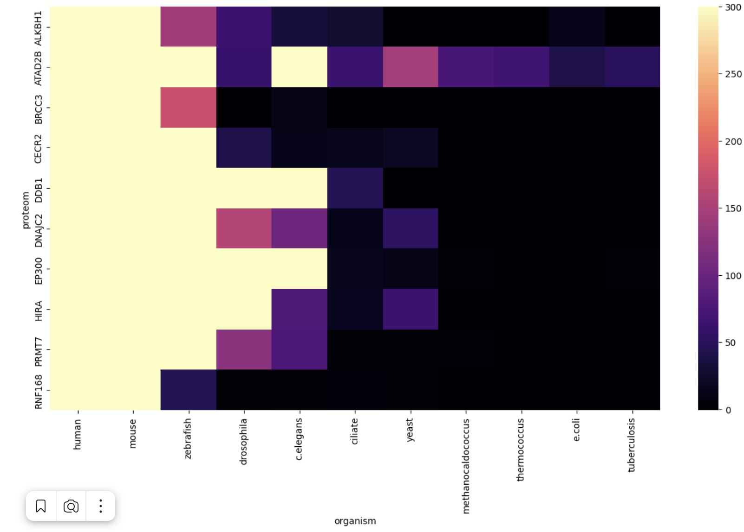
Общая тепловая карта

Slide 5
Информация о далеких гомологах
Ген | Название | Идентификатор | Длина | Описание | Домены
ALKBH1 | 2OG-Fe(II) oxygenase family protein | XP_977046.1 | 408 | - | 2OG-FeII_Oxy super family
BRCC3 | F37A4.5 | NP_498470.1 | 319 | A novel essential fission yeast gene pad1+ positively regulates pap1(+)-dependent transcription and is implicated in the maintenance of chromosome structure | MPN_RPN_CSN5
EP300 | histone acetyltransferase p300 isoform X8 | XP_009297689.1 | 2617 | CBP and p300 are critical regulators of hematopoiesis through both their transcriptional coactivator and acetyltransferase activities. | HAT_KAT11, KIX, RING_CBP-p300, ZZ_CBP, zf-TAZ, PHD_SF super family
CECR2 | BAZ2A | NP_498673.3 | 1390 | BAZ2A is an epigenetic regulator affecting transcription of ribosomal RNA. | Bromo_BAZ2A_B, HAT_MBD, PHD_BAZ2A, DDT super family, PHD, WHIM1, WSD super family

Slide 6
Информация о далеких гомологах
Ген | Название | Идентификатор | Длина | Описание | Домены
DNAJC2 | DnaJ domain protein [Tetrahymena thermophila SB210] | XP_001016844.1 | 929 | - | PRK10767 super family, terminal_TopJ super family, zf-C2H2_jaz, 2A1904 super family
DDB1 | splicing factor 3B subunit 3 [Tetrahymena thermophila SB210] | XP_001032740.1 | 1197 | - | -
HIRA | Hir1p | NP_009545.2 | 840 | The HIR(histone regulation) negative regulator play important role in the transcription of six of the eight core histone genes during the Saccharomyces cerevisiae cell cycle. The phenotypes of hir1 mutants suggested that the wild-type HIR1 gene encode transcriptional repressors that function in the absence of direct DNA binding. | WD40 SuperFamily, TUP-1 like enhancer of split
RNF168 | E3 ubiquitin-protein ligase rnf168 isoform X1 (Danio rerio (zebrafish)) | XP_021337022.1 | 474 | Predicted to enable several functions, including K63-linked polyubiquitin modification-dependent protein binding activity; ubiquitin binding activity; and ubiquitin-protein transferase activity. | RING-HC, MIU2, UDM1

Slide 7
Информация о далеких гомологах
Ген | Название | Идентификатор | Длина | Описание | Домены
PRMT7 | Protein arginine N-methyltransferase 7 (Caenorhabditis elegans) | NP_492436.2 | 647 | Plays a role in the regulation of gene expression, cell differentiation and DNA repair. PRMT7 is also involved in the regulation of immune responses, interacts with other proteins, and performs protein methylation, including histones. | AdoMet_MTases
ATAD2B | Yta7p | NP_011786.1 | 1379 | Membrane-associated protein localized both to the nucleus and to the endoplasmic reticulum. Its deletion affected the enzymatic activity of cis-prenyltransferase and the cellular levels of isoprenoid compounds. | RecA-like_Yta7-like, SpoVK, Bromo_TBP7_like

Slide 8
Связь далеких гомологов с модификацией H2A/H2B
Статей о выбранных белках-ортологах мало, но установить связь с модификацией H2A/H2B удалось.
Модификация H2A/H2B в дрожжах: Diverse Roles for Histone H2A Modifications in DNA Damage Response Pathways in Yeast
BAZ2A: Truncation of Histone H2A’s C-terminal Tail, as Is Typical for Ni(II)-Assisted Specific Peptide Bond Hydrolysis, Has Gene Expression Altering Effects
Hir1p: [Hira gene and development: from yeast to human]

Slide 9
Выводы
Проведенный анализ показывает, что модификации гистонов H2A/H2B появляются как минимум у дрожжей, что говорит о наличии данной эпигенетической модификации у одноклеточных эукариот
Исследования показывают, что эпигенетическая функция найденных белков-ортологов действительно совпадает с функцией исследованных белков

